Slide 1

RECURSION AND BACKTRACKING

Slide 2
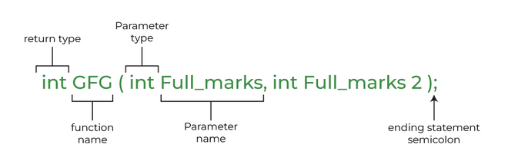
FUNCTIONS
A function is a set of statements that take inputs, do some specific computation, and produce output.
The idea is to put some commonly or repeatedly done tasks together and make a function so that instead of writing the same code again and again for different inputs, we can call the function.

Slide 3

RECURSION

Slide 4
RECURSION STEPS
What will happen if base case is wrong?
Stack Overflow!!
The algorithmic steps for implementing recursion in a function are as follows:
Step 1 - Define a base case: Identify the simplest case for which the solution is known or trivial. This is the stopping condition for the recursion, as it prevents the function from infinitely calling itself.
Step 2 - Define a recursive case: Define the problem in terms of smaller subproblems. Break the problem down into smaller versions of itself, and call the function recursively to solve each subproblem.
Step 3 - Ensure the recursion terminates: Make sure that the recursive function eventually reaches the base case, and does not enter an infinite loop.
Step 4 - Combine the solutions: Combine the solutions of the subproblems to solve the original problem.

Slide 5
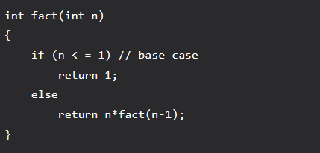
FACTORIAL
Time Complexity = O(n)

Slide 6
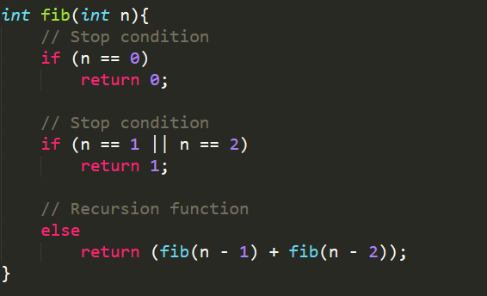
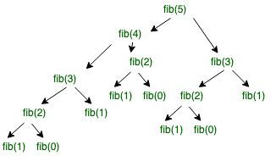
FIBONACCI
Time Complexity = O(2^{n})
Notes:
Fibonacci

Slide 7
PRACTICE
Problem1: https://codeforces.com/problemset/problem/535/B
Solution1: https://ideone.com/Gjiyfo

Slide 8
KNAPSACK PROBLEM
Statement:
We are given N items where each item has some weight and profit associated with it. We are also given a bag with capacity W, [i.e., the bag can hold at most W weight in it]. The target is to put the items into the bag such that the sum of profits associated with them is the maximum possible.
Note: The constraint here is we can either put an item completely into the bag or cannot put it at all [It is not possible to put a part of an item into the bag].

Slide 9
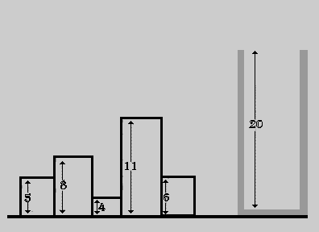
KNAPSACK PROBLEM
Statement:
We are given N items where each item has some weight and profit associated with it. We are also given a bag with capacity W, [i.e., the bag can hold at most W weight in it]. The target is to put the items into the bag such that the sum of profits associated with them is the maximum possible.
Note: The constraint here is we can either put an item completely into the bag or cannot put it at all [It is not possible to put a part of an item into the bag].

Slide 10
KNAPSACK PROBLEM
Approach:
A simple solution is to consider all subsets of items and calculate the total weight and profit of all subsets. Consider the only subsets whose total weight is smaller than W. From all such subsets, pick the subset with maximum profit.
Optimal Substructure: To consider all subsets of items, there can be two cases for every item.
Case 1: The item is included in the optimal subset.
Case 2: The item is not included in the optimal set.

Slide 11
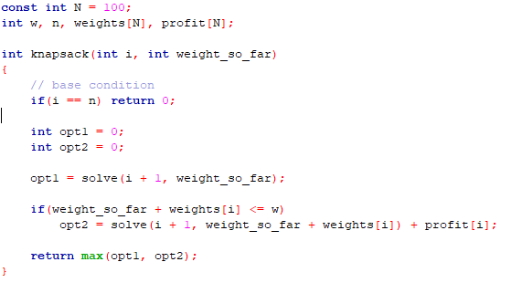
KNAPSACK PROBLEM
Solution:

Slide 12
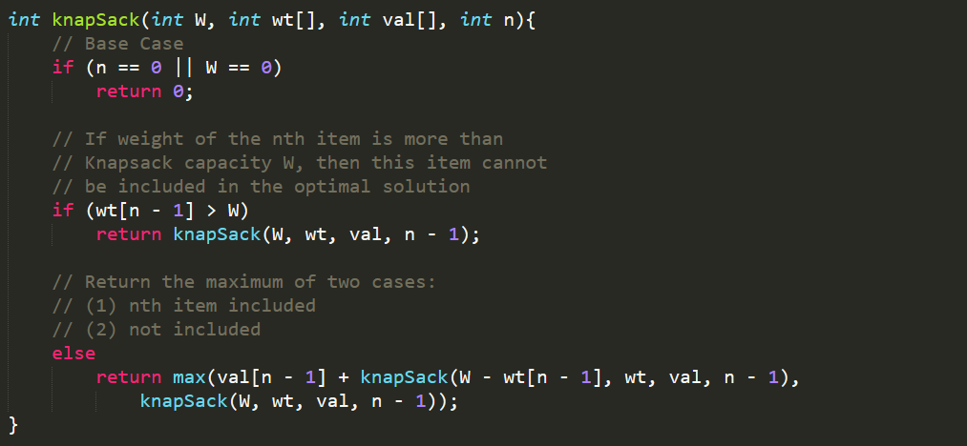
KNAPSACK PROBLEM
Alternative solution:

Slide 13
PRACTICE
Problem2: https://vjudge.net/problem/UVA-12455
Solution2.1: https://vjudge.net/solution/49152654
Solution2.2: https://vjudge.net/solution/49152660

Slide 14

BACKTRACKING
Backtracking can be defined as a general algorithmic technique that considers searching every possible combination in order to solve a computational problem.
he idea behind the backtracking technique is that it searches for a solution to a problem among all the available options.
We start the backtracking from one possible option and if the problem is solved with that selected option then we return the solution else we backtrack and select another option from the remaining available options.

Slide 15
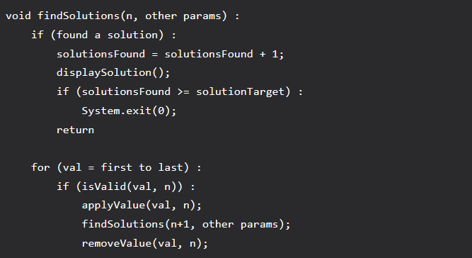
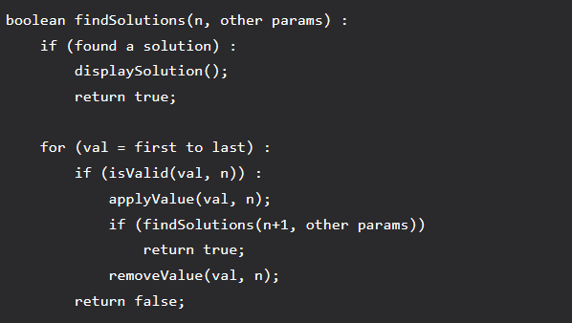
BACKTRACKING
Code Structure:

Slide 16
PRACTICE
Problem3: https://leetcode.com/problems/n-queens/
Solution3: https://ideone.com/5K7aU6

